Slide 1
Data Types
Dr. Hakem Beitollahi
Computer Engineering Department
Elmo Sanat University
Notes:
The University of Adelaide, School of Computer Science
Chapter 2 — Instructions: Language of the Computer

Slide 2
Outline
Data Types
— <number>

Slide 3
Data Types

Slide 4
Data Types (I)
Types
Access
Composite
(equivalent to pointers in C)
allows dynamic memory allocation
Scalar
Array
Record
Integer
Real
Boolean
Character
Bit
Std_logic
Enumerated
Physical

Slide 5
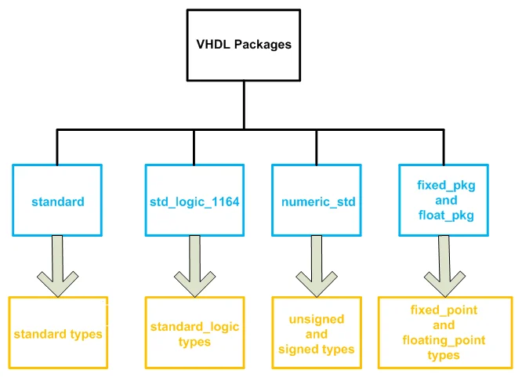
Data Types (II)
— <number>

Slide 6
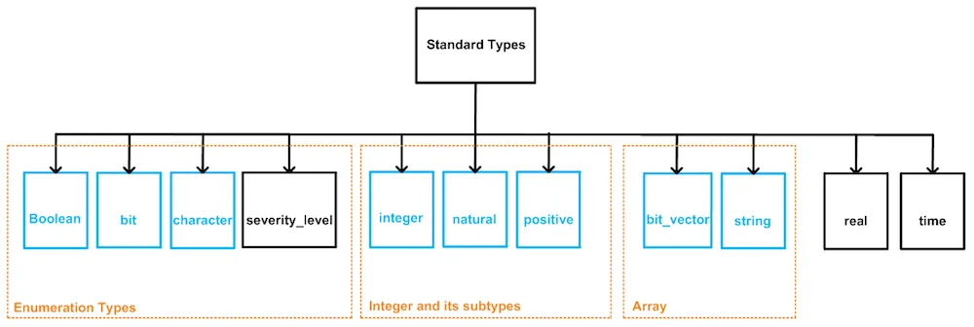
Data Types (III)
— <number>

Slide 7
Data Types (II)
Scalar Types
  Integer Type
    Minimum range for any implementation as defined by standard: -2,147,483,648 to 2,147,483,647
  Natural type (subtype of integer)
    Minimum range for any implementation as defined by standard: 0 to 2,147,483,647
  Positive type (subtype of integer)
    Minimum range for any implementation as defined by standard: 1 to 2,147,483,647
  Real Type [Simulation only]
    Minimum range for any implementation as defined by standard: -1.0E38 to 1.0E38
  Boolean Type
    It has two values of “True” and “False”
  Character type [Simulation only]
    It supports all characters such as ‘a’..’z’, ‘[‘, ‘{‘ and etc.
  Bit type
    It has two values of ‘1’ and ‘0’
  Std_ulogic type:
    It is IEEE standard
    contain: ‘U’, ‘X’, ‘0’, ‘1’, ‘Z’, ‘w’, ‘L’, ‘H’, ‘-’
  Std_logic type (subtype of std_ulogic)
    It is IEEE standard
    contain: ‘U’, ‘X’, ‘0’, ‘1’, ‘Z’, ‘w’, ‘L’, ‘H’, ‘-’

Slide 8
STD_LOGIC
STD_LOGIC is defined in the library std_logic_1164.This is a nine valued logic system.
  It has 9 values: 'U', 'X', '0', '1', 'Z', 'W', 'L' ,'H' and '-'.
  The meaning of each of these characters are:
    U = uninitialized [Simulation only]
    X = unknown - a multisource line is driven '0' and '1' simultaneously [synthesizable]
    0 = logic 0 [synthesizable]
    1 = logic 1 [synthesizable]
    Z = high impedance (tri state) [synthesizable]
    W = weak unknown [Simulation only]
    L = weak ‘0’[Simulation only]
    H = weak ‘1’[Simulation only]
    - = don't care [Simulation only]

Slide 9
Data Types (IV)
Some examples
  x0 <= '0'; -- bit or std_logic gets '0‘
  x1 <= "00011111"; -- bit_vector, std_logic_vector, signed, or unsigned
  x2 <= "0001_1111"; -- underscore allowed to ease visualization (work only for std_logic)
  x3 <= "101111" -- binary representation of decimal 47
  x4 <= B"101111" -- binary representation of decimal 47
  x6 <= X"2F" -- hexadecimal representation of decimal 47
  n <= 1200; -- integer
  m <= 1_200; -- integer, underscore allowed
  IF ready THEN... -- Boolean, executed if ready=TRUE
  y <= 1.2E-5; -- real, not synthesizable
— <number>

Slide 10
Data Types (V)
Example: Legal and illegal operations between data of different types
SIGNAL a: BIT;
SIGNAL b: BIT_VECTOR(7 DOWNTO 0);
SIGNAL c: STD_LOGIC;
SIGNAL d: STD_LOGIC_VECTOR(7 DOWNTO 0);
SIGNAL e: INTEGER RANGE 0 TO 255;
...
a <= b(5);
b(0) <= a;
c <= d(5);
d(0) <= c;
a <= c;
b <= d;
e <= b;
e <= d;
c<=a;
-- legal (same scalar type: BIT)
-- legal (same scalar type: BIT)
-- legal (same scalar type: STD_LOGIC)
-- legal (same scalar type: STD_LOGIC)
-- illegal (type mismatch: BIT x STD_LOGIC)
-- illegal (type mismatch: BIT_VECTOR x STD_LOGIC_VECTOR)
-- illegal (type mismatch: INTEGER x BIT_VECTOR)
-- illegal (type mismatch: INTEGER x STD_LOGIC_VECTOR)
-- illegal (type mismatch: between c and a
— <number>

Slide 11
Std_ulogic vs. std_logic (I)
The two types std_logic and std_ulogic both have in common that they can represent the following values:
‘1’ | Logic 1
‘0’ | Logic 0
‘Z’ | High impedance
‘W’ | Weak signal, can’t tell if 0 or 1
‘L’ | Weak 0, pulldown
‘H’ | Weak 1, pullup
‘-‘ | Don’t care
‘U’ | Uninitialized
‘X’ | Unknown, multiple drivers
— <number>

Slide 12
Std_ulogic vs. std_logic (II)
Std_ulogic is the unresolved type
  if multiple drivers are driving different values onto a signal of the std_ulogic type, that’s not going to work.
  Conflicting drivers is an error in VHDL.
  The simulation won’t compile, or the design won’t synthesize.
  if we try to compile this in ModeSim, it reports the following error:
    ** Error: C:/proj/tb.vhd(8): Nonresolved signal 'Sig1' has multiple sources.
Note that bit and bit_vector are also unresolved
architecture sim of UnresolvedTb is
signal Sig1 : std_ulogic := '0';
begin
-- Driver A
Sig1 <= '0';
-- Driver B
Sig1 <= '1' after 20 ns;
end architecture;
— <number>

Slide 13
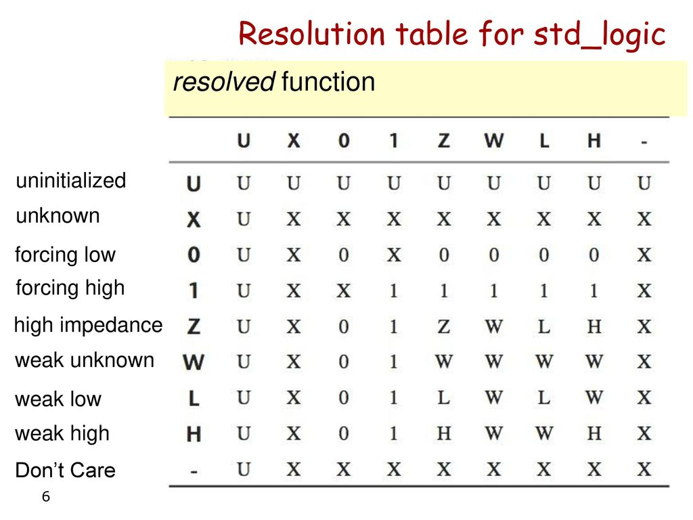
Std_ulogic vs. std_logic (III)
std_logic – The resolved type
  The std_logic can represent the same values as the std_ulogic, but it’s a resolved type.
  SUBTYPE std_logic IS resolved std_ulogic;
— <number>

Slide 14
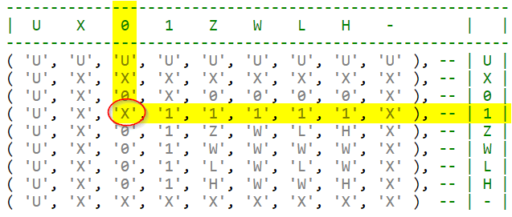
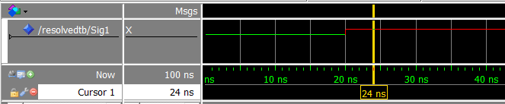
Std_ulogic vs. std_logic (IV)
Repeat the same example
The code now compiles in ModelSim without errors. When we run it, it produces this waveform:
architecture sim of UnresolvedTb is
signal Sig1 : std_logic := '0';
begin
-- Driver A
Sig1 <= '0';
-- Driver B
Sig1 <= '1' after 20 ns;
end architecture;
— <number>

Slide 15
Data Types (III)
Scalar Types (cntd.)
  Enumerated Types [synthesizable]
    A type whose values are defined by listing (enumerating) them explicitly.
    Mostly state machines use it
    Example:
  Physical Types: [Simulation only]
    A numeric type for representing some physical quantity, such as mass, length, time or voltage.
Type state_type is (start, idle, waiting, run)
Signal state: state_type;
TYPE resistence IS RANGE 0 to 1000000
UNITS
ohm; -- ohm
Kohm = 1000 ohm; -- 1 K
Mohm = 1000 kohm; -- 1 M
END UNITS;

Slide 16
Data Types (IV)
  Physical type (cntd.) [Simulation only]
  Time units are the only predefined physical type in VHDL
TYPE TIME IS RANGE -2147483647 to 2147483647
UNITS
fs; -- femtosecond
ps = 1000 fs; -- picosecond
ns = 1000 ps; -- nanosecond
us = 1000 ns; -- microsecond
ms = 1000 us; -- millisecond
sec = 1000 ms; -- second
min = 60 sec; -- minute
hr = 60 min; -- hour
END UNITS;

Slide 17
User-Defined Data Types
VHDL also allows the user to define his/her own data types
  TYPE my_integer IS RANGE -32 TO 32;
  -- A user-defined subset of integers.
  TYPE student_grade IS RANGE 0 TO 100;
  -- A user-defined subset of integers or naturals.
  Enumerated Types
    TYPE color IS (red, green, blue, white);
      -- Another enumerated data type.
— <number>

Slide 18
Data Types (VIII)
Subtype
  A type with a constraints
  Assignments that are out of the subtype range result in an error
  Main reason for using a subtype rather than specifying a new type
    Though operations between data of different types are not allowed, they are allowed between a subtype and its corresponding base type
      Assignment from subtype to base type and vice versa is possible and ok.
  Example
    Subtype my_int is integer range 0 to 3215;
    subtype byte1 is std_logic_vector(7 downto 0);
    SUBTYPE my_logic IS STD_LOGIC RANGE '0' TO 'Z';
    -- Recall that STD_LOGIC=('X','0','1','Z','W','L','H','-').
    -- Therefore, my_logic=('0','1','Z').

Slide 19
Data type (An example)
Which one is legal and which one is illegal
SUBTYPE my_logic IS STD_LOGIC RANGE '0' TO '1';
SIGNAL a: BIT;
SIGNAL b: STD_LOGIC;
SIGNAL c: my_logic;
...
b <= a;
b <= c;
--illegal (type mismatch: BIT versus STD_LOGIC)
--legal (same "base" type: STD_LOGIC)
— <number>

Slide 20
Subtype (An example)
See the code
architecture Behavioral of example is
Subtype A1 is integer range -8 to 8;
Subtype B1 is integer range -16 to 16;
subtype C1 is B1 range -4 to 4;
signal x:integer;
signal y: A1;
signal z:B1;
signal w:C1;
begin
x<=y; --Ok and no error
y<=x; --OK and no error
y<=z; --OK and no error
z<=w; --OK and no error
y<=w; --OK and no error
end Behavioral;
— <number>

Slide 21
Downto vs. to in VHDL
If you take a processor, for Little endian systems we can use "downto" and for Bigendian systems we use "to".
  signal t1 : std_logic_vector(7 downto 0); --7th bit is MSB and 0th bit is LSB here.
  and,
  signal t2 : std_logic_vector(0 to 7); --0th bit is MSB and 7th bit is LSB here.
  You are free to use both types of representations, just have to make sure that other parts of the design are written accordingly.
— <number>

Slide 22
Data Types (Array I)
Composite Types
  Array Types:
    Used to collect one or more elements of a similar type in a single construct
    Elements can be any VHDL data type
    They can be one-dimensional (1D), two-dimensional (2D), or one-dimensional-by-one-dimensional (1Dx1D).
    Other dimensions are possible, but NOT synthesizable

Slide 23
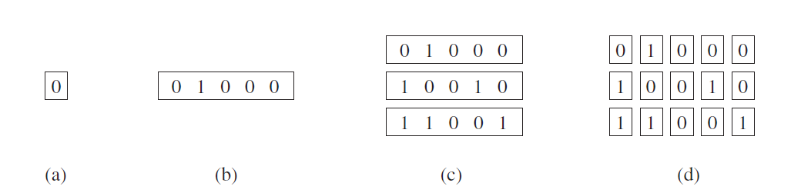
Data Types (Array II)
(a): scalar (single bit)
(b) 1D also called vector
(c) 1Dx1D
(d) 2D
[synthesizable]
Predefined Scalars: BIT, STD_LOGIC, and BOOLEAN
Predefined Vectors: BIT_VECTOR, STD_LOGIC_VECTOR, INTEGER, SIGNED, and UNSIGNED
[synthesizable]
— <number>

Slide 24
Data Types (Array III)
There are no pre-defined 2D or 1Dx1D arrays
  must be specified by the user
To do so, the new TYPE must first be defined
The new SIGNAL, VARIABLE, or CONSTANT can be declared using that data type
To make use of the new array type:
TYPE type_name IS ARRAY (specification) OF data_type;
SIGNAL signal_name: type_name [:= initial_value];
— <number>

Slide 25
Data Types (Array IV)
Example: 1Dx1D array
Alternative way
TYPE row IS ARRAY (7 DOWNTO 0) OF STD_LOGIC; -- 1D array
TYPE matrix IS ARRAY (0 TO 3) OF row; -- 1Dx1D array
SIGNAL x: matrix; -- 1Dx1D signal
TYPE matrix IS ARRAY (0 TO 3) OF STD_LOGIC_VECTOR(7 DOWNTO 0);
— <number>

Slide 26
Data Types (Array V)
Example: 2D array
Example: Array initialization
TYPE matrix2D IS ARRAY (0 TO 3, 7 DOWNTO 0) OF STD_LOGIC;
-- 2D array
0
1
2
3
7
6
5
4
3
2
1
0
... :="0001"; -- for 1D array
... :=('0','0','0','1') -- for 1D array
... :=(('0','1','1','1'), ('1','1','1','0')); -- for 1Dx1D or -- 2D array
— <number>

Slide 27
Data Types (Array VI)
Multi-dimensional array (more)
  Example:
    Type data4x8 is array (0 to 3) of std_logic_vector(7 downto 0);
    Type data3x4x8 is array (0 to 2) of data4x8;
    Type truth_table is array(0 to 7, 0 to 4) Of BIT;
    Access of array elements by an example
Architecture rtl of ex is
Signal a_vect : std_logic_vector (4 downto 0)
Begin
A_vect(4)<=‘1’;
A_vect(3 downto 0)<=“0110”;
End rtl;

Slide 28
Data Types (Array VII)-Example
TYPE row IS ARRAY (7 DOWNTO 0) OF STD_LOGIC; -- 1D array
TYPE array1 IS ARRAY (0 TO 3) OF row; -- 1Dx1D array
TYPE array2 IS ARRAY (3 downto 0) OF STD_LOGIC_VECTOR(7 DOWNTO 0); -- 1Dx1D
TYPE array3 IS ARRAY (0 TO 3, 7 DOWNTO 0) OF STD_LOGIC; -- 2D array
SIGNAL x: row;
SIGNAL y: array1;
SIGNAL v: array2;
SIGNAL w: array3;
Types of scalar assignments- all of them are legal
x(0) <= y(1)(2); -- notice two pairs of parenthesis -- (y is 1Dx1D)
x(1) <= v(2)(3); -- two pairs of parenthesis (v is 1Dx1D)
x(2) <= w(2,1); -- a single pair of parenthesis (w is 2D)
y(1)(1) <= x(6);
y(2)(0) <= v(0)(0);
y(0)(0) <= w(3,3);
w(1,1) <= x(7);
w(3,0) <= v(0)(3);
— <number>

Slide 29
Data Types (Array VII)-Example
TYPE row IS ARRAY (7 DOWNTO 0) OF STD_LOGIC; -- 1D array
TYPE array1 IS ARRAY (0 TO 3) OF row; -- 1Dx1D array
TYPE array2 IS ARRAY (0 TO 3) OF STD_LOGIC_VECTOR(7 DOWNTO 0); -- 1Dx1D
TYPE array3 IS ARRAY (0 TO 3, 7 DOWNTO 0) OF STD_LOGIC; -- 2D array
SIGNAL x: row;
SIGNAL y: array1;
SIGNAL v: array2;
SIGNAL w: array3;
Vector assignments
x <= y(0);
x <= v(1);
x <= w(2);
x <= w(2, 2 DOWNTO 0);
-- legal (same data types: ROW)
-- illegal (type mismatch: ROW x --STD_LOGIC_VECTOR)
-- illegal (w must have 2D index)
-- illegal (type mismatch: ROW x -- STD_LOGIC)
v(0) <= w(2, 2 DOWNTO 0);
v(0) <= w(2);
y(1) <= v(3);
y(1)(7 DOWNTO 3) <= x(4 DOWNTO 0);
v(1)(7 DOWNTO 3) <= v(2)(4 DOWNTO 0);
w(1, 5 DOWNTO 1) <= v(2)(4 DOWNTO 0);
-- illegal (mismatch: STD_LOGIC_VECTOR -- x STD_LOGIC)
-- illegal (w must have 2D index)
-- illegal (type mismatch: ROW x -- STD_LOGIC_VECTOR)
-- legal (same type, -- same size)
-- legal (same type, -- same size)
-- illegal (type mismatch)
— <number>

Slide 30
Data Types (VII)
Composite Types (contd.)
  Record type
    Used to collect one or more elements of a different types in single construct
    Elements can be any VHDL data type
    Elements are accessed through field name
Architecture beh of ex is
Type data is record
Year: integer range 1996 to 2099;
Month: integer range 1 to 12;
val: std_logic_vector(7 downto 0);
Check: Bit;
End record;
Signal d: data;
Begin
d.year<=2008;
d.month<=4;
d.val<=“01110111”
d.check<=‘1’;
End;

Slide 31
Data Type (Signed and Unsigned)
These types are defined in the std_logic_arith package of the ieee library.
SIGNAL x: SIGNED (7 DOWNTO 0);
SIGNAL y: UNSIGNED (0 TO 3);
  Notice that their syntax is similar to that of STD_LOGIC_VECTOR
  An UNSIGNED value is a number never lower than zero
  If type SIGNED is used instead, the value can be positive or negative
SIGNED and UNSIGNED data types are intended mainly for arithmetic operations (similar to integer signals)
Unlike std_logic_vector, logical operations are not allowed
— <number>

Slide 32
Data Type (Signed and Unsigned)
LIBRARY ieee;
USE ieee.std_logic_1164.all;
USE ieee.std_logic_arith.all; -- extra package necessary
...
SIGNAL a: SIGNED (7 DOWNTO 0);
SIGNAL b: SIGNED (7 DOWNTO 0);
SIGNAL x: SIGNED (7 DOWNTO 0);
...
v <= a + b; -- legal (arithmetic operation OK)
w <= a AND b; -- illegal (logical operation not OK)
LIBRARY ieee;
USE ieee.std_logic_1164.all; -- no extra package required
...
SIGNAL a: STD_LOGIC_VECTOR (7 DOWNTO 0);
SIGNAL b: STD_LOGIC_VECTOR (7 DOWNTO 0);
SIGNAL x: STD_LOGIC_VECTOR (7 DOWNTO 0);
...
v <= a + b; -- illegal (arithmetic operation not OK)
w <= a AND b; -- legal (logical operation OK)
— <number>

Slide 33
Data types
There is a simple way of allowing data of type STD_LOGIC_VECTOR to participate directly in arithmetic operations
Using packages std_logic_signed or std_logic_unsigned
LIBRARY ieee;
USE ieee.std_logic_1164.all;
USE ieee.std_logic_unsigned.all; -- extra package included
...
SIGNAL a: STD_LOGIC_VECTOR (7 DOWNTO 0);
SIGNAL b: STD_LOGIC_VECTOR (7 DOWNTO 0);
SIGNAL x: STD_LOGIC_VECTOR (7 DOWNTO 0);
...
v <= a + b; -- legal (arithmetic operation OK), unsigned
w <= a AND b; -- legal (logical operation OK)
— <number>

Slide 34
Data Conversion
— <number>

Slide 35
Data Conversion (I)
VHDL does not allow direct operations (arithmetic, logical, etc.) between data of different types.
It is often necessary to convert data from one type to another.
If the data are closely related, then the std_logic_1164 of the ieee library provides straightforward conversion functions
TYPE long IS INTEGER RANGE -100 TO 100;
TYPE short IS INTEGER RANGE -10 TO 10;
SIGNAL x : short;
SIGNAL y : long;
...
y <= 2*x + 5; -- error, type mismatch
y <= long(2*x + 5); -- OK, result converted into type long
— <number>

Slide 36
Data Conversion (II)
Conversion using predefined functions
Data conversion functions can be found in the std_logic_arith package
  conv_integer(p) : Converts a parameter p of type INTEGER, UNSIGNED or SIGNED to an INTEGER value.
    Notice that STD_LOGIC_VECTOR is not included.
  conv_unsigned(p, b): Converts a parameter p of type INTEGER, UNSIGNED or SIGNED, to an UNSIGNED value with size b bits.
  conv_signed(p, b): Converts a parameter p of type INTEGER, UNSIGNED or SIGNED to a SIGNED value with size b bits.
  conv_std_logic_vector(p, b): Converts a parameter p of type INTEGER, UNSIGNED,or SIGNED to a STD_LOGIC_VECTOR value with size b bits.
— <number>

Slide 37
Data Conversion (III)
Example
LIBRARY ieee;
USE ieee.std_logic_1164.all;
USE ieee.std_logic_arith.all;
...
SIGNAL a: IN UNSIGNED (7 DOWNTO 0);
SIGNAL b: IN UNSIGNED (7 DOWNTO 0);
SIGNAL y: OUT STD_LOGIC_VECTOR (7 DOWNTO 0);
...
y <= CONV_STD_LOGIC_VECTOR ((a+b), 8);
-- Legal operation: a+b is converted from UNSIGNED to an
-- 8-bit STD_LOGIC_VECTOR value, then assigned to y.
— <number>

Slide 38
Check Yourself
Consider the following data types:
a <= x(2);
b <= x(2);
b <= y(3,5);
b <= w(5)(3);
y(1)(0) <= z(7);
x(0) <= y(0,0);
x <= "11100000";
a <= "0000000";
y(1) <= x;
w(0) <= y;
w(1) <= (7=>'1', OTHERS=>'0');
w(2)(7 DOWNTO 0) <= x;
w(0)(7 DOWNTO 6) <= z(5 DOWNTO 4);
x(3) <= x(5 DOWNTO 5);
y <= ((OTHERS=>'0'), (OTHERS=>'0'),
(OTHERS=>'0'), "10000001");
z(6) <= x(5);
z(6 DOWNTO 4) <= x(5 DOWNTO 3);
z(6 DOWNTO 4) <= y(5 DOWNTO 3);
y(0, 7 DOWNTO 0) <= z;
w(2,2) <= '1';
TYPE array1 IS ARRAY (7 DOWNTO 0) OF STD_LOGIC;
TYPE array2 IS ARRAY (3 DOWNTO 0, 7 DOWNTO 0) OF STD_LOGIC;
TYPE array3 IS ARRAY (3 DOWNTO 0) OF array1;
SIGNAL a : BIT;
SIGNAL b : STD_LOGIC;:
SIGNAL x : array1;
SIGNAL y : array2;
SIGNAL w : array3;
SIGNAL z : STD_LOGIC_VECTOR (7 DOWNTO 0);
Which statement of the red-rectangle is illegal and which is correct
— <number>
Notes:
The University of Adelaide, School of Computer Science
Chapter 2 — Instructions: Language of the Computer

Slide 39
Answer of check yourself
a <= x(2); -- Error Type of a1 is incompatible with type of x
b <= x(2);
b <= y(3,5);
b <= w(5)(3); -- Error 5 is not included in the index range, 3 downto 0, of array w.
y(1)(0) <= z(7); -- Error Wrong index type for y.
x(0) <= y(0,0);
x <= "11100000";
a <= "0000000"; --Error Type of a1 is incompatible with type of 0000000.
y(1) <= x; --Error Wrong index type for y.
w(0) <= y; -- Error Type of w is incompatible with type of y.
w(1) <= (7=>'1', OTHERS=>'0');
w(2)(7 DOWNTO 0) <= x;
w(0)(7 DOWNTO 6) <= z(5 DOWNTO 4); --Error Type of w is incompatible with type of z.
x(3) <= x(5 DOWNTO 5); --Error Type of x is incompatible with type of x.
y <= ((OTHERS=>'0'), (OTHERS=>'0'),
(OTHERS=>'0'), "10000001");
z(6) <= x(5);
z(6 DOWNTO 4) <= x(5 DOWNTO 3); --Error Type of z is incompatible with type of x.
z(6 DOWNTO 4) <= y(5 DOWNTO 3); --Error Wrong slice type for y.
y(0, 7 DOWNTO 0) <= z; --Error parse error, unexpected DOWNTO, expecting COMMA or CLOSEPAR
w(2,2) <= '1'; --Error Wrong index type for w.
— <number>

